Slide 1


LEAD:
Developing Your Leadership Mindset
Notes:
[Company Welcome]
[Facilitator Intro]

Slide 2
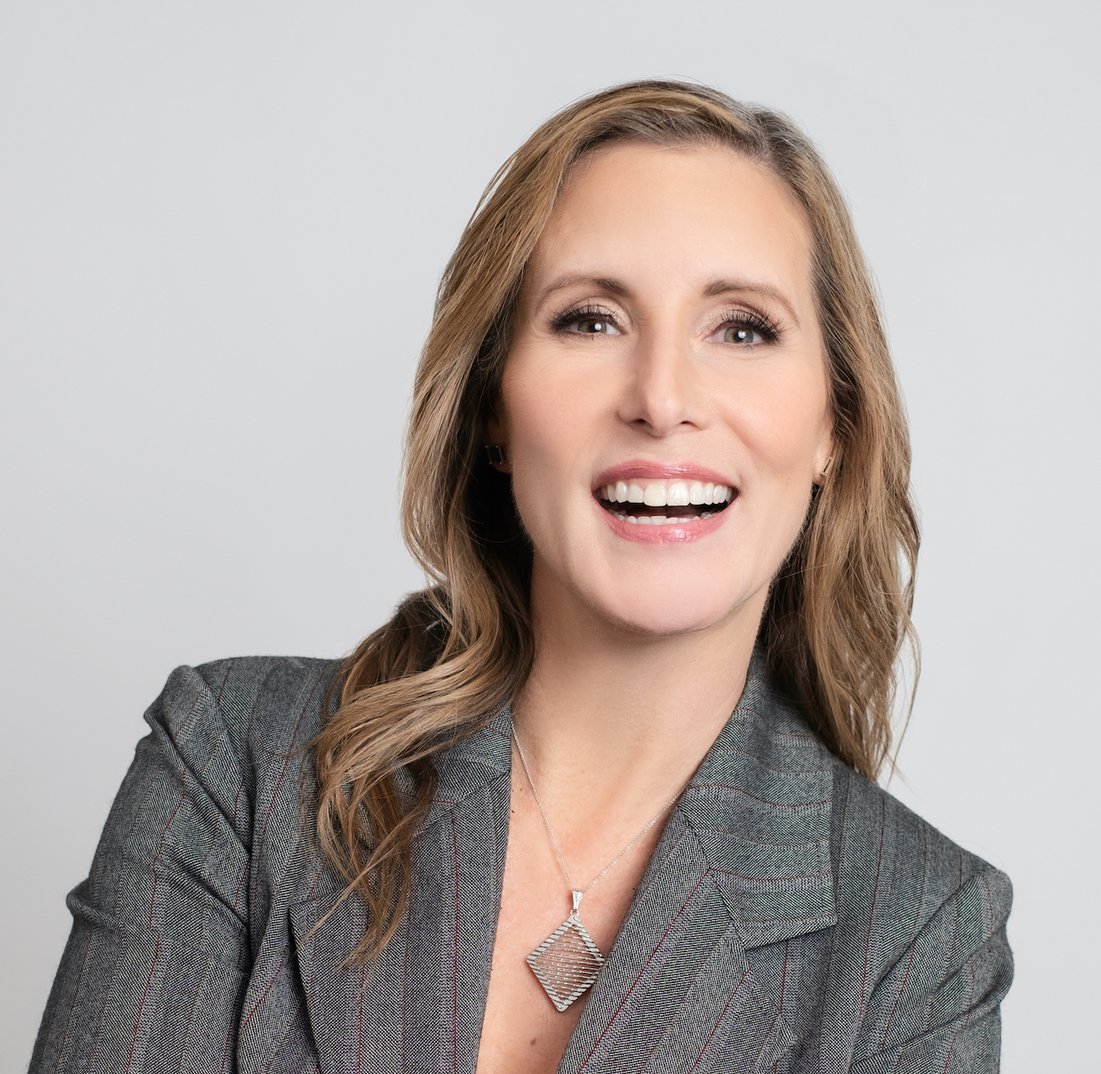
Meet Your Facilitator!
Dr. Ali Atkison
Expertise in how the adult brain learns
Coach, Facilitator & Professional Speaker
Leads with a curious mindset
Fitness buff, reader, wife

Slide 3



Icebreaker
Share a recommendation.
Notes:
Amanda

Slide 4
Today’s Objectives
  Set the stage. Understand the role of a leader-manager and what behaviors lead to your success.
  Review and leverage your strengths and identify strategies to mitigate your trouble spots based on your DiSC profile.
  Take personal ownership for your success as a manager by staying above the line.
  Begin to craft your Leadership Mission (work throughout the program).
Notes:
Amanda

Slide 5

LEAD Development Process
Cohort 12
DiSC & Pre-Competency Assessment
Post-Competency Assessment
Feedback and Accounta-bility Conver-sations
Leading Through Conflict
Leading Through Change
Building Trust on Your Team
Kickoff & Developing a Leadership Mindset
Making Commit-ments
&
GRAD-UATION!
Communi- cation in Leadership
July 21
In-person
August 20
Virtual
September 10
Virtual
October 15
In-person
November 12
Virtual
December 10
Virtual
January 2027
2 hours
2 hours
12-4 pm ET
1:30-4 pm ET
1:30-4 pm ET
1-4 pm ET
1:30-4 pm ET
1:30-4 pm ET
Between Sessions: application exercises, accountability partner connection, follow-up, and reminders

Slide 6




Leader Development: Ingredients for Growth
Focus
Accountability
Psychological
Safety
Time

Slide 7
Pre-Assessment Results
Survey Item | Group Average
I understand the connection between mindset and effectively leading others. | 4.1
I have a Leadership Mission which drives my leadership. | 4.3
I know my natural leadership style and use it to actively leverage my strengths and manage my weaknesses. | 3.3
Notes:
Ali

Slide 8

Notes:
Ali
p.1 What is YOUR leadership ripple? Use the notes section below to jot down a few ideas.
As a result of this session you will be able to…
Identify your leadership style and the impact your style has on others
Improve interactions with others through:
knowledge of your behaviors
knowledge of others’ behaviors
strategies to modify behaviors

Slide 9

The Manager Difference
Notes:
Amanda

Slide 10
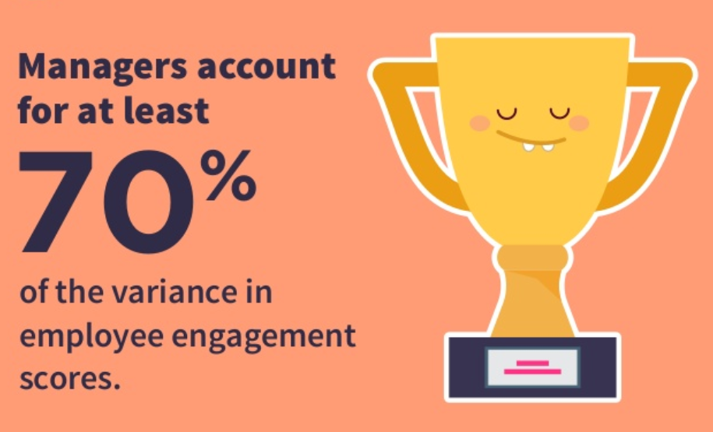
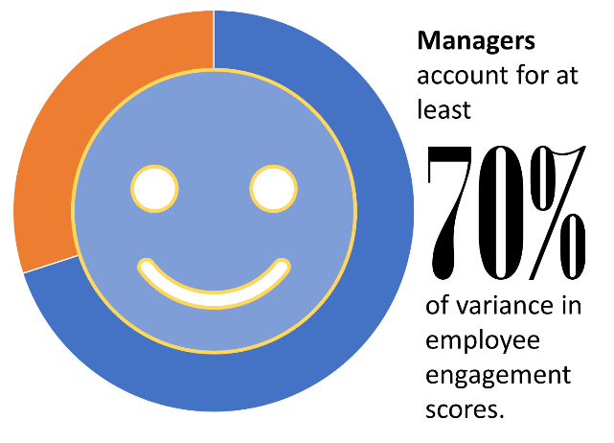
The Manager Difference
  NEW GRAPHIC
Notes:
Amanda

Slide 11
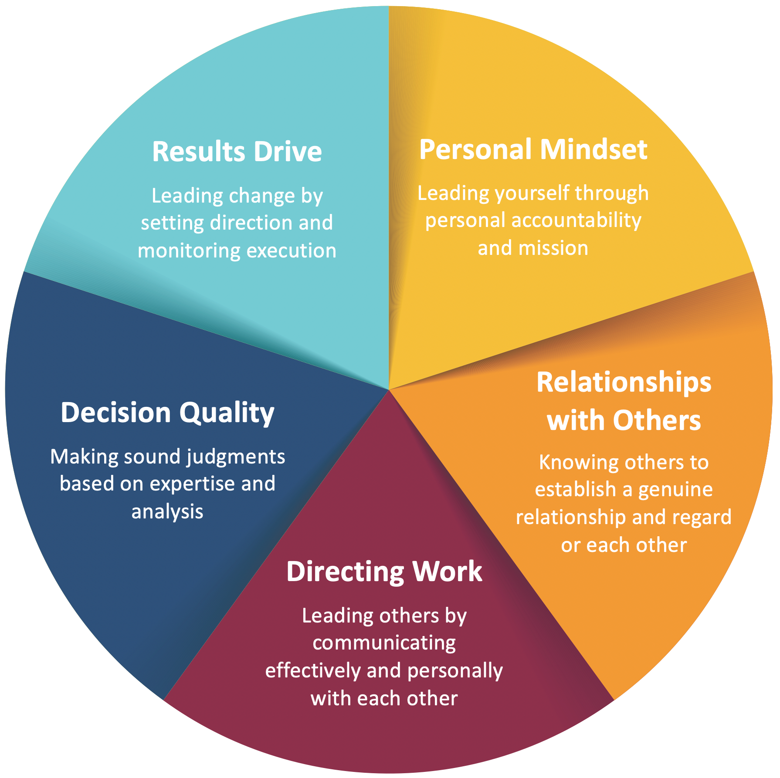
Role of a Leader-Manager
A balanced wheel is important to your overall performance.
Notes:
Amanda

Slide 12
Understanding the Leader-Manager Wheel
Consider a leader who made an impact on you—good or bad.
Choose 5 words to describe this leader.
Write each descriptor on the wheel where it belongs.
Share your story of the leader who impacted you with a partner.
Notes:
Amanda

Slide 13
Your Leadership Starts with YOUR MINDSET
Your Mindset
What You Do
The Results You Get
Notes:
Ali

Slide 14
Mindset
The major factor in whether people achieve expertise is not some fixed prior ability or intelligence (which is NOT fixed), but rather purposeful engagement.
~Robert Sternberg

Slide 15
Mindset
You must have two things to grow in any way:
A growth mindset—an understanding that intelligence is not fixed, coupled with a genuine interest in learning.
The willingness to be present and do the work.

Slide 16
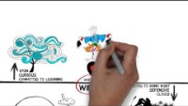
Own Your Success
Notes:
Ali

Slide 17
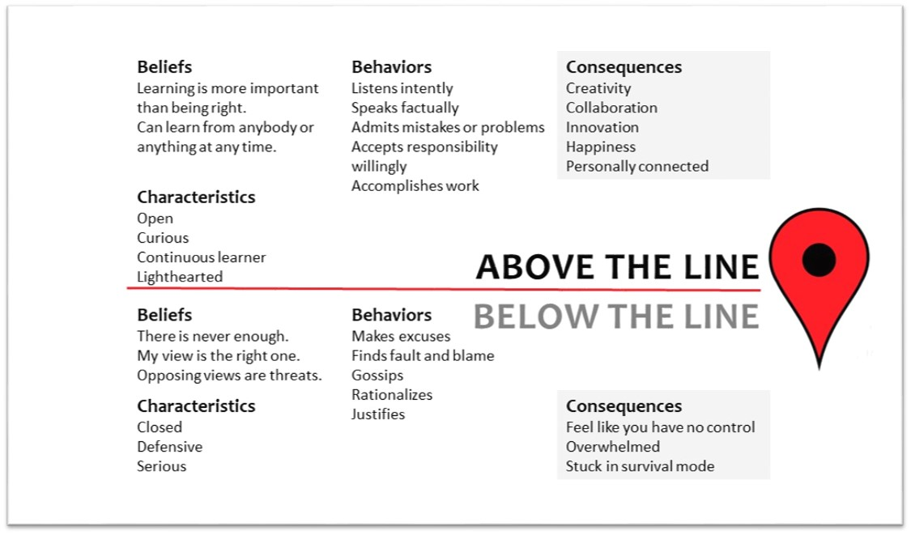
Where is YOUR Mindset?
Highlight the beliefs, characteristics, and behaviors that best describe you.
Provide (1) example of a time you were above the line, and (1) example of a time you were below the line.
Notes:
Ali

Slide 18

What Anchors You?
Notes:
Ali

Slide 19
What Are Your Values?
Hope Curiosity Security Happiness
Trust Wisdom Empathy Loyalty
Challenge Power Quality Communication
Growth Harmony Beauty Open-mindedness
Healthy Recognition Discipline Love/Affection
Strength Flexibility Creativity Competence
Intelligence Productivity Patience Independence
Teamwork Humor Effectiveness Decisiveness
Innovation Diversity Service Success
Equality Autonomy Truth Dependability
Respect Courage Honesty/Integrity

Slide 20

What Do I Do With My Values?
Find a way to keep them close/easily accessible
Connect them to a motto
Find a visual that illustrates them
Use them to inform your Leadership Mission

Slide 21
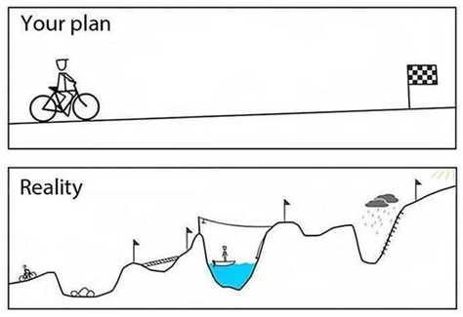
Look Familiar?
Notes:
Ali

Slide 22
Your Leadership Mission
Who are you? When you are clear on who you are, you have a firm foundation to consistently base your decisions and actions.
Leadership Mission Statement
Identify your leadership focus.
Pinpoint behaviors that support your focus.
Define your influence.
Be emotional.
Keep it positive.
Keep it balanced.

Slide 23
Sample LM Statements
I want to spread knowledge and motivate others.
To inspire an atmosphere where mutual respect and honesty exist.
To empower my team to achieve greatness through encouragement, direction, and proper support.
Develop. Educate. Empower.

Slide 24
DiSC Overview
What does it measure—4 dimensions:
Dominance—how you react to challenge
Influence—how you influence others
Steadiness—How you respond to the pace of the environment
Conscientiousness—how you respond to rules
DISC Principles:
DISC does not measure intelligence, character, or education and skills.
Every style is valuable—there is no right or wrong.
We all have some level of each style; we tend to have a dominant (core) style
We all have blind spots. Self-awareness brings clarity and drives change.
Focus is on the Platinum Rule: Treat others the way they wish to be treated.
Notes:
Ali

Slide 25
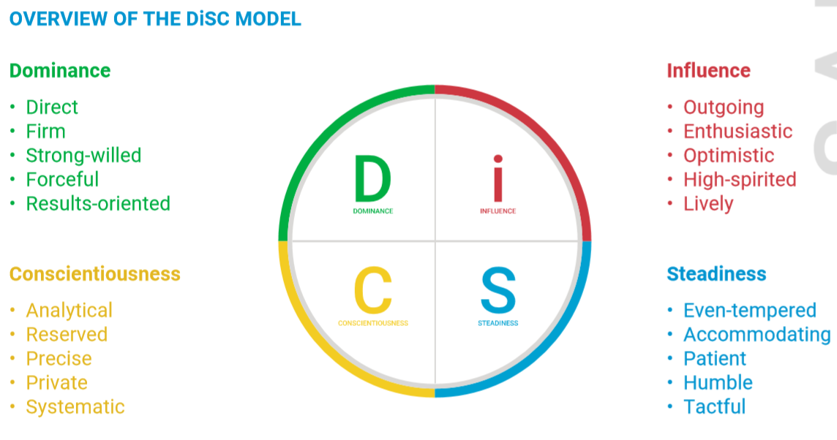
What is DiSC?
Notes:
Ali
Pg 2 –what is DiSC
DISC is a self-assessment that measures how an individual prefers to interact with others. DISC creates a common language and a self-awareness to better understand ourselves and others. improve awareness, teamwork, communication, and productivity.
4 dimensions: D, I, S, C
D:
Goal-Oriented
Results Driven
Demanding of High Standards
Direct & purposeful
Competitive
Risk Taker
Igniter
Strategic/big picture
I
Enthusiasm
Optimism
Creativity
Facilitator
Energize/motivate
Promotion
Intuitive
Relationships
S
Patient/composed
Great at finishing
Calm/stabilizing
Predictable
Loyal
Team builder
Processes
Service
Resistance
C
Meticulous
Criticizes, tests
Quality conscious
Follows rules
Factual & direct
High standards
Detail Oriented
Problem Analysis
Objectivity

Slide 26
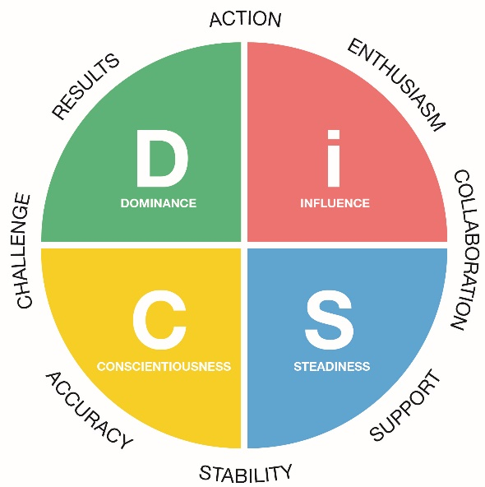
DiSC Model Review
Notes:
Ali

Slide 27

YOUR DiSC Style
Review your DiSC report:
Read pages 2-7 and 17-20 FOR YOUR CORE STYLE
  next to statements that are like you
  X next to statements that are not like you
  ? next to statements you are not sure about
Note any questions you have about the DiSC assessment or your profile
Be prepared to share key attributes of your style with the large group (strengths & opportunities).
Notes:
Ali

Slide 28
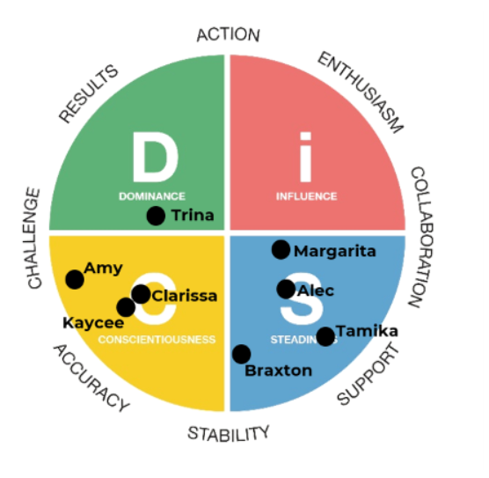
Group DiSC Map
Notes:
Ali

Slide 29
The DiSC Styles Breakout
D
i
What words describe your core style?
How might your style show up to others—how might it be misunderstood?
C
S
Notes:
p.8 (the p.8 after p.3) take notes in your breakout group about YOUR DiSC style
Use the summary pages 4-7 in your participant guide Understanding Behavior Style and your DiSC report
Write down the characteristics/motivators/values/stressors you heard from your teammates as they shared their DiSC styles. When we come back together, you will teach the rest of the group about your style and also some of the negative aspects: how much you “show up” to others?
10 min. Teach Back

Slide 30
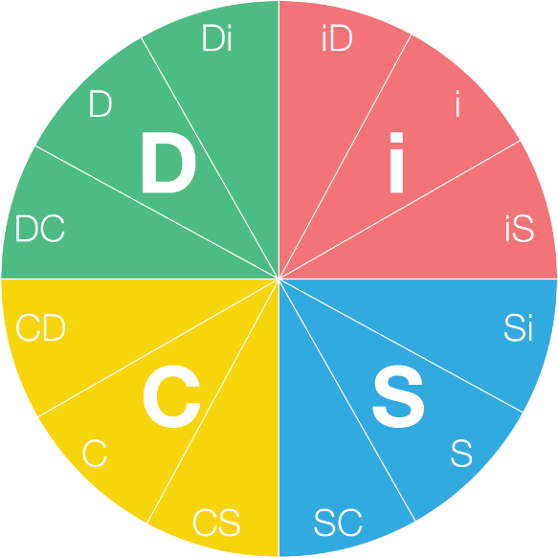
Your Inclination
Slight
Moderate
Strong
Notes:
Ali
p.3
We will talk a little bit later about your dot placement and that dots relationship to other styles, but right now, let’s really focus on self-awareness of our core styles.

Slide 31

How do I react?
Notes:
Amanda
Let’s say my dot is here.
I have to travel farther to get to the dot in the C style—it’s the same way with our core attributes. Its possible, but it does take me some time or energy to get on the same page.
Let’s take a few minutes so you can fill out the chart on p.12 entitled How do I react? Identify your reaction to the other DiSC styles—remember no one else will see this. It is a safe space to write down what might be difficult for you or how you might need to adapt to other styles, which is what we will focus on next.

Slide 32
Leadership and DiSC
Ignite things
Results driven
Strategic thinking
Risk taking
Stretch goals
Fast
Promoting ideas
Facilitating win-win
Motivating
Creative solutions
Relationship building
Change agents
Engaging followers
Break-through ideas
Implementation Controllers Gate keeping
Team builders
Consensus
Coaching
Task
People
Operations
Measurability
Project management
Analysis
Quality
Testing
Procedures
Rules
Completion of tasks
Processes
Systems
Incremental Improvements
Service
Deliberate
Notes:
Amanda
I mentioned before that we would talk about your dot and the relationship to other people. This visual, located also on p.11 of your PG represents attributes that how up for each core style when they are leading—it identifies their orientation and pace—how you might identify someone elses DiSC style even if you didn’t hear it from them.
Ask, “are they people or task oriented?” “Are they fast thinkers, talkers, or are they more deliberate in their pace?” This is also a great time to talk about the energy is takes to interact with folks who are far away from you on the DiSC wheel? Does it drain you? Probably.

Slide 33
Levels of Accountability
Peer Accountability
Manager Accountability
Self Accountability
Notes:
Ali

Slide 34
Manager Meeting
Discuss content from previous session – what were your key takeaways?
Discuss areas of strength and areas of development.
Discuss how you can continue to support each other.
Notes:
Ali

Slide 35


The Value of Accountability
65%
95%
Notes:
Ali
Michael Jordan—breakfast club

Slide 36
Accountability Partnerships
Help to “keep the ideas and content alive” between workshops
Will serve as a visual reminder of your ongoing leadership development
Safe person with whom to share ideas, actions, obstacles
Notes:
Ali

Slide 37
Accountability Partnerships
GROUP 1 | GROUP 2
Amy Acton | Kaycee Ward
Margarita Borukhova | Tamika Strickland
Braxton Davis | Trina Johnson
Clarissa Hernandez | Alec Graham
Notes:
Ali

Slide 38
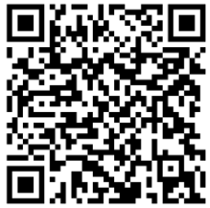
Your Action Items
Meet with your accountability partners. Use the discussion questions below to talk through your thinking, test ideas, and learn from one another’s perspectives.
Meet with your manager. Use the same questions to explore application, identify barriers, and discuss how our manager can support practice and reinforcement.
Your discussion questions:
  What are your take-aways from Above the Line?
  What are your values? Why did you choose them, and how will you live them?
  What are your strengths/opportunities from your DiSC report?
Begin work on your Leadership Mission.

Slide 39
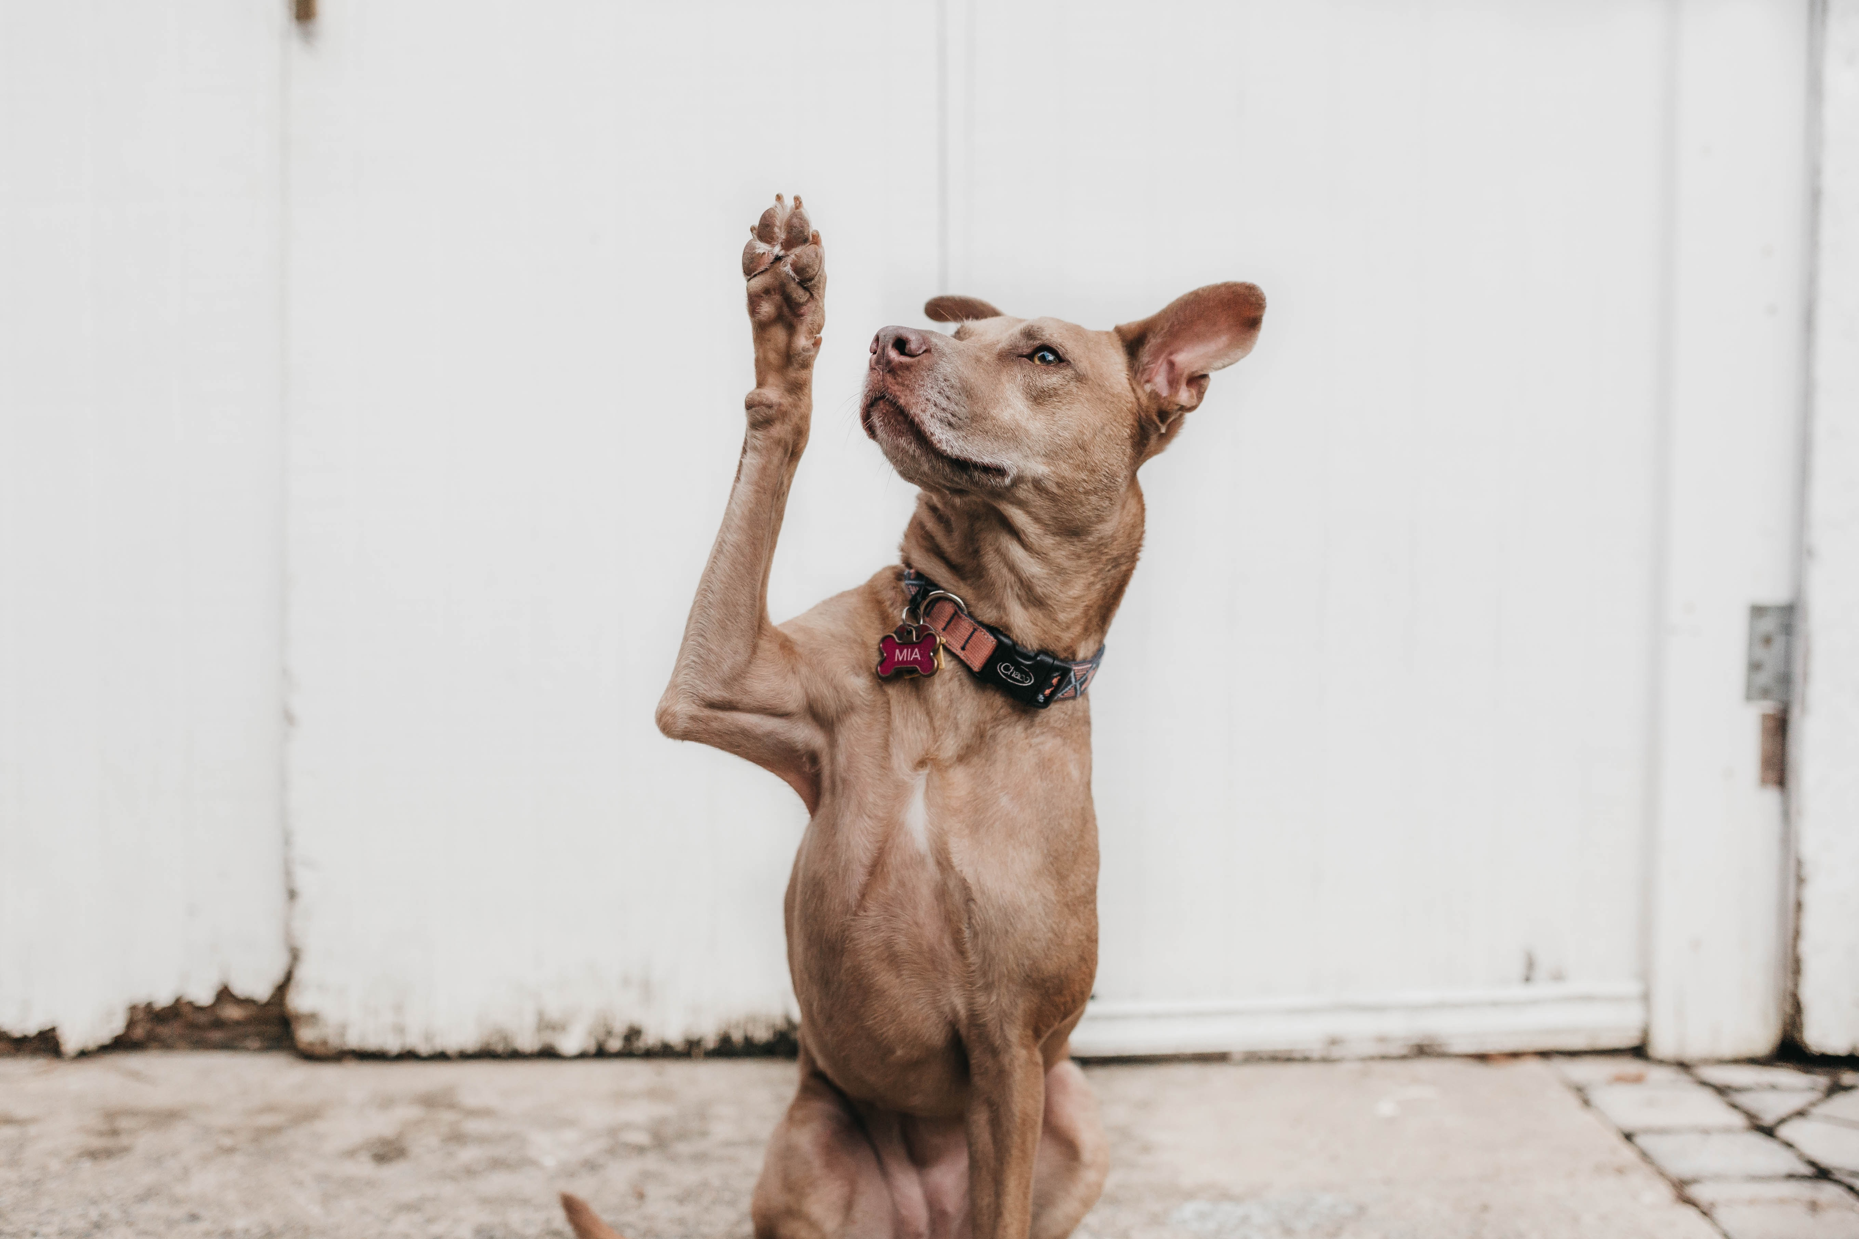
Questions?

Slide 40
LEAD Development Process
Cohort 12
DiSC & Pre-Competency Assessment
Post-Competency Assessment
Feedback and Accounta-bility Conver-sations
Leading Through Conflict
Leading Through Change
Building Trust on Your Team
Kickoff & Developing a Leadership Mindset
Making Commit-ments
&
GRAD-UATION!
Communi- cation in Leadership
July 21
In-person
August 20
Virtual
September 10
Virtual
October 15
In-person
November 12
Virtual
December 10
Virtual
January 2027
2 hours
2 hours
12-4 pm ET
1:30-4 pm ET
1:30-4 pm ET
1-4 pm ET
1:30-4 pm ET
1:30-4 pm ET
Between Sessions: application exercises, accountability partner connection, follow-up, and reminders

